Slide 1
“MOOD” Based Activity Analysis
----Mood Scriber

Slide 2
Introduction:
I used Power BI to Visualize the data provided by the “Mood Scriber” Application.
In addition to the data set provided by the company I included a new column “date” to the dataset and also increased the no of columns to 365 (1year) of data according to the Mood Scriber app. As it is an AI daily dairy for journaling mood tracking for better writing and mental wellness.
It includes the emotions like:
1.Happy
2.Sad
3.Angry
4.Depressed
5.Rad
6.Awful
7.Neutral
8.Lonely
These Emotions are included as moods in dataset
It also includes the way we feel and the reason for we feel these were considered as Activity1 and Activity2 in dataset.

Slide 3
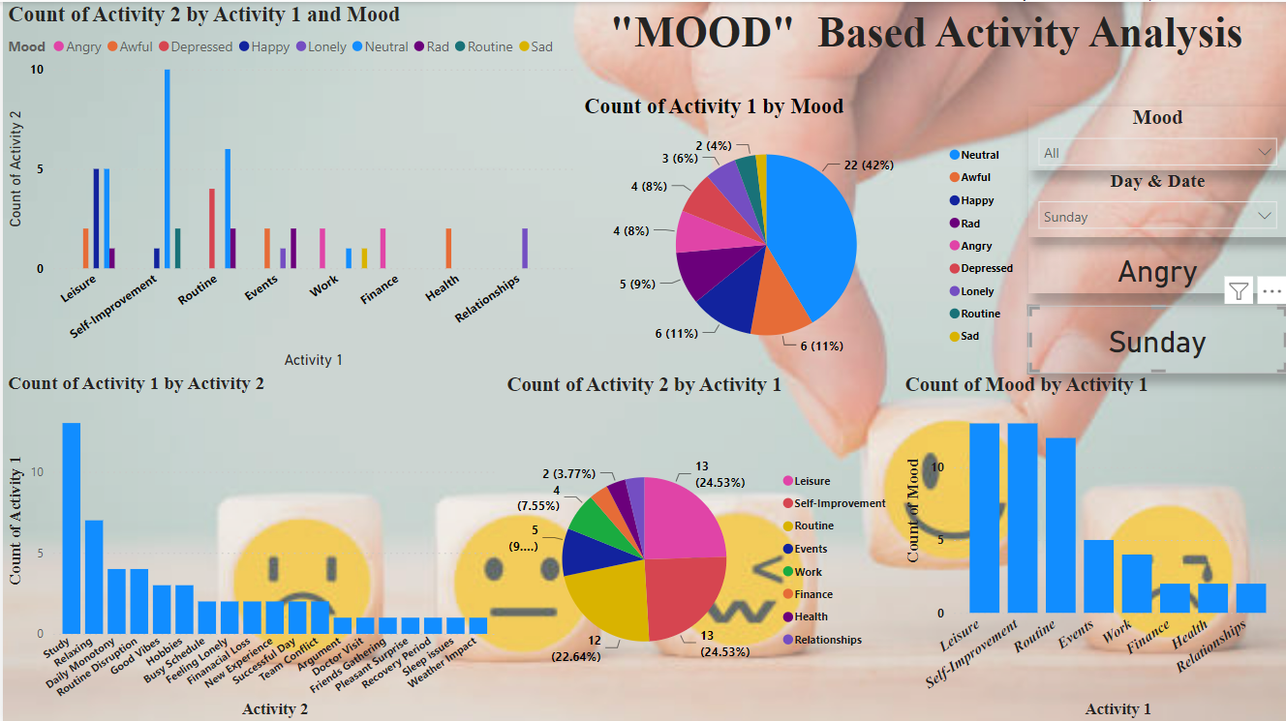
The Dashboard for mood scriber activities.

Slide 4
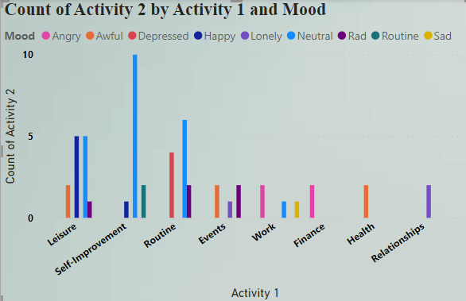
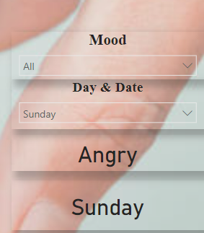
It is Clustered column chart used to compare the two activities based on mood with count. So, that we can able to identify the activities comparsion over mood.
I used slicers for Mood and Day & Date in the drop down manner to select in which date and day the graphs should be display, and also used cards for displaying the specific emotion and the day for the selected.

Slide 5
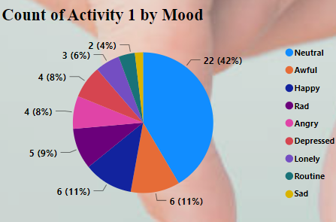
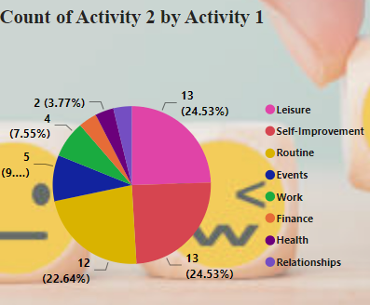
The pie chart shows the occupancy of the activities over mood. Here I created two individual pie charts.
This is for count of activity 1 by Mood.
This pie chart shows the percentage of activity2 in activity1 as per the mood.

Slide 6
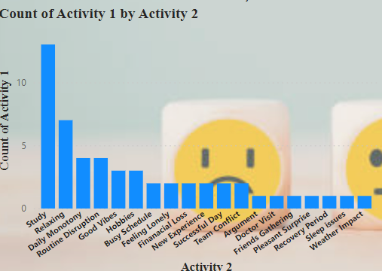
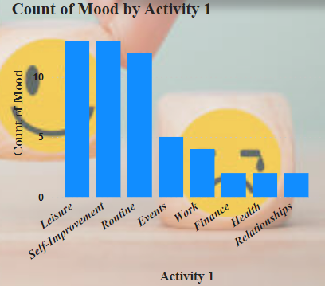
As we know the Bar graphs are used to compare the multiple objects at once .
In this bar graph we compares the activity1 over activity2
This graph show the count of mood over Activity1.

Slide 7
Conclusion:
With the help of the MoodScriber App I got to analyse ,Visualize and developed a dashboard according to the data of the persons mood and activities that leading to feel, in detailed manner.
My work in the Power BI attached here.

Slide 8
Thank You

